Slide 1

Socio-economic issues: new jobs, new training and changes in the workers' rights pact

Slide 2
Key drivers: The changing Landscape of work
Technological Advancement
Globalization
Climate Change and Sustainability demand
Demographics Shifts

Slide 3
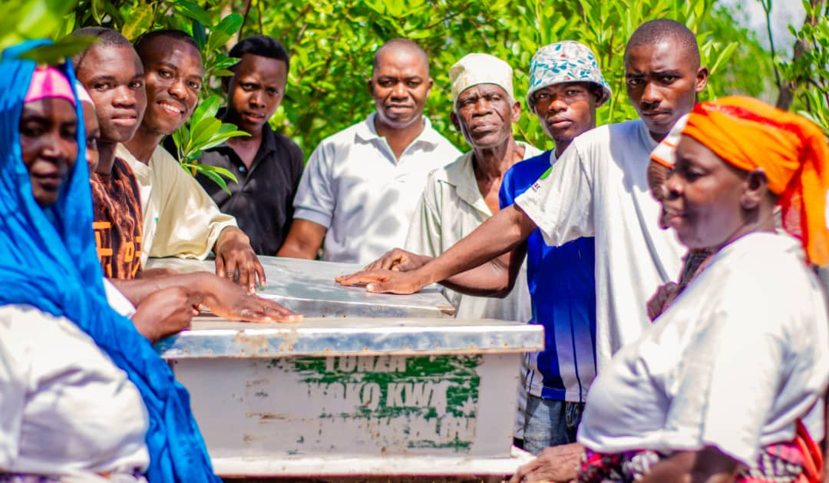
Opportunities for New Jobs
Blue Economy

Slide 4
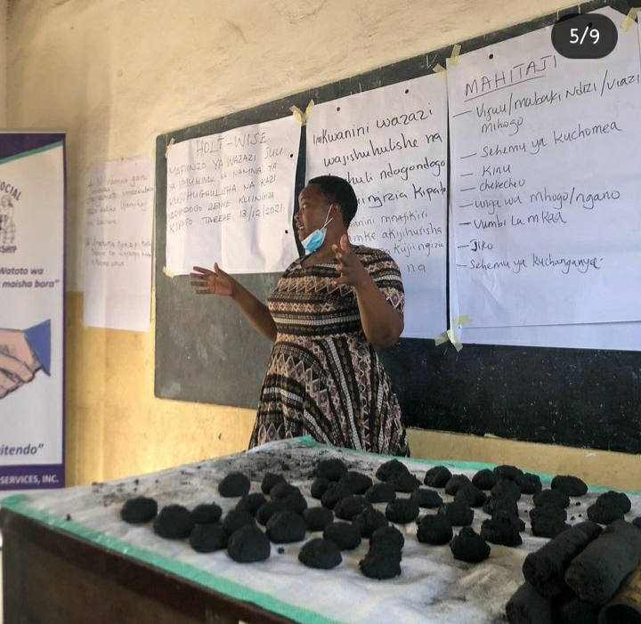
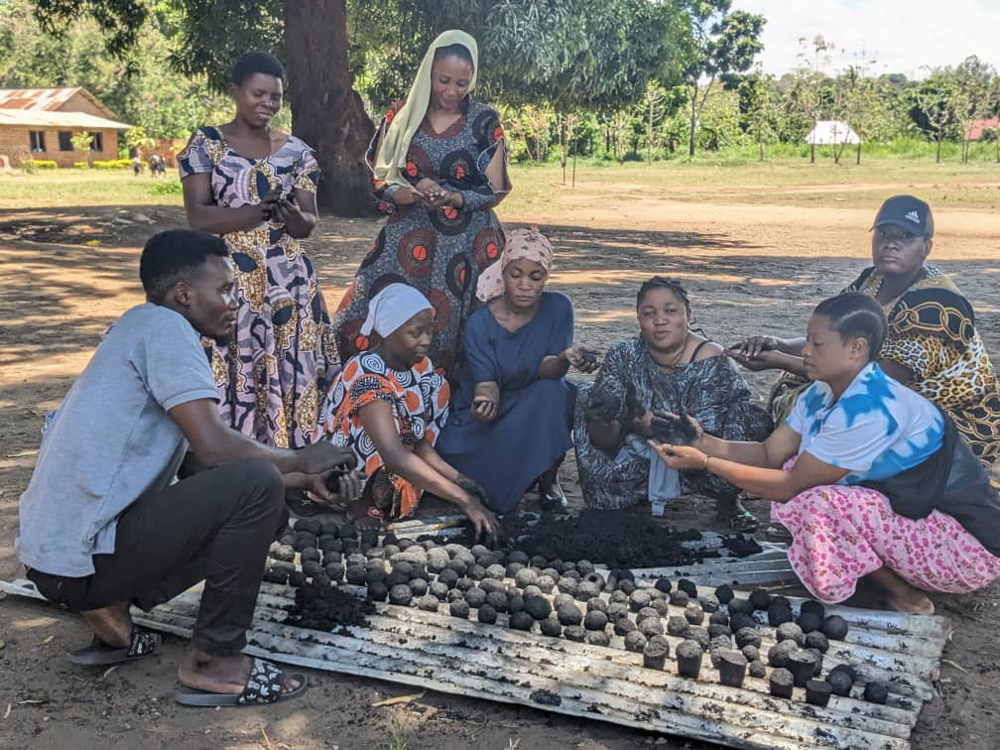
Renewable Energy and Green Technologies

Slide 5

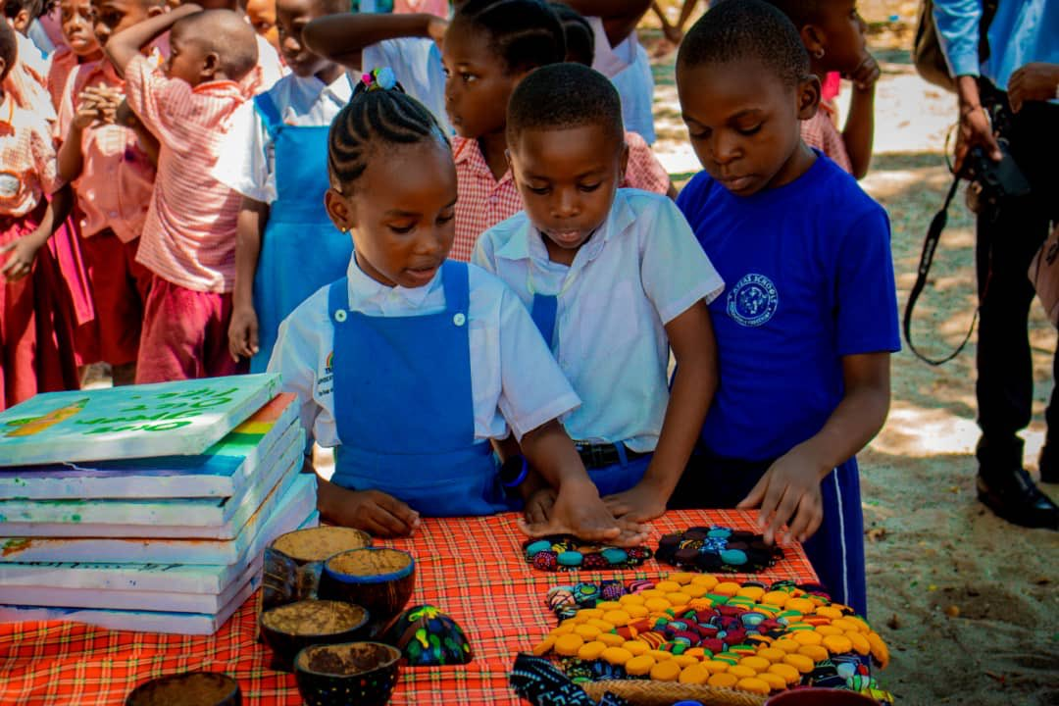
Circular Economy

Slide 6
Challenges facing Employment sector
Mismatch between current skills and future job requirements
Lack of Training programs
Misalignment of Education and Labor Market Needs
Climate Change

Slide 7
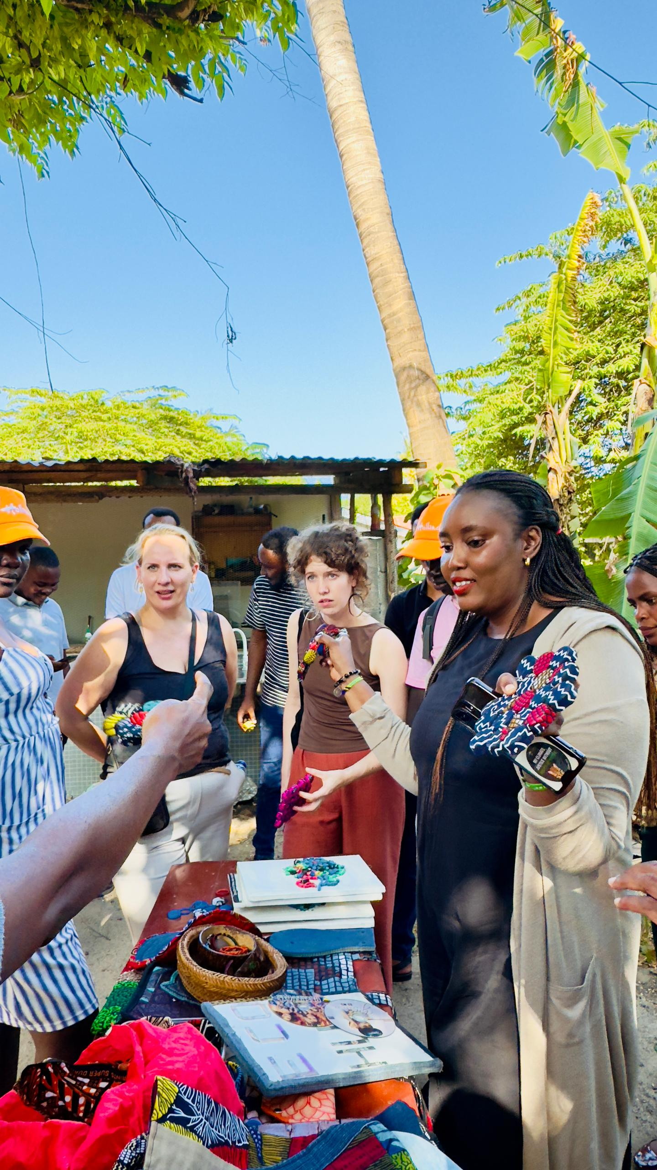
What should be done to reduce skill gap
Need for upskilling and reskilling initiatives

Slide 8

Cont..
Training Programs
Trained 126 schools in DSM, Lindi, Mtwara and Iringa about Micro-forest.
Trained SWM to 8 Schools in Bagamoyo, 16 in DSM, 3 in Morogoro.
Trained 628 Youths to make alternative charcoal and 12 groups are working in different parts of Tanzania.
Trained 1460 women in 6 regions within Tanzania about Composting.
Trained SWM to 38 schools in DSM, 8 in Iringa and 6 schools in Lindi.

Slide 9
THANK YOU!

